Slide 1
Software Engineering Presentation
By: Karl Miller, Tadhg Savage and Aisha Ntuli

Slide 2
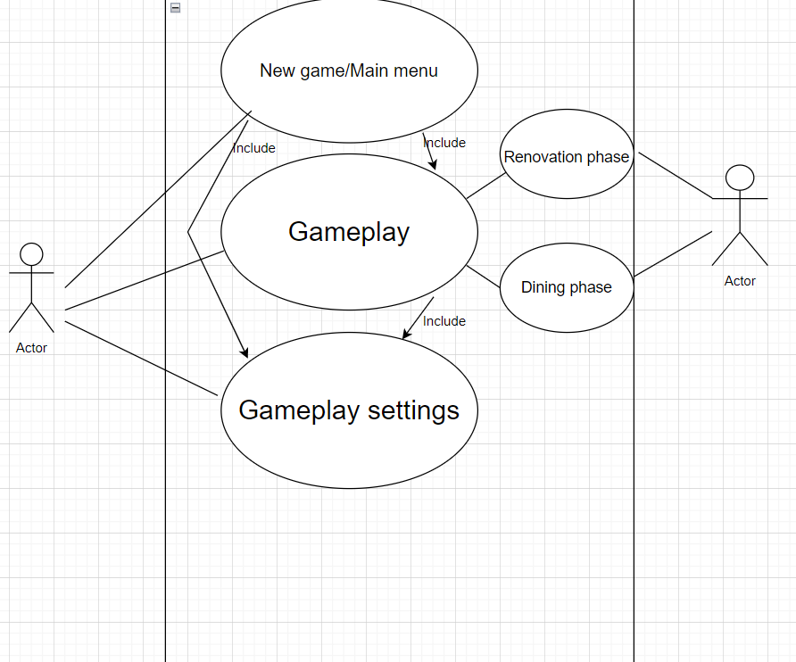
Use-case diagram
The actor on the left is the player of the game and the actor on the right is the GameStateSManager
The GameStateManager takes care of the game related things like swapping the game phases between dining and renovation
The include statements mean that certain use cases include the functionality of others.

Slide 3
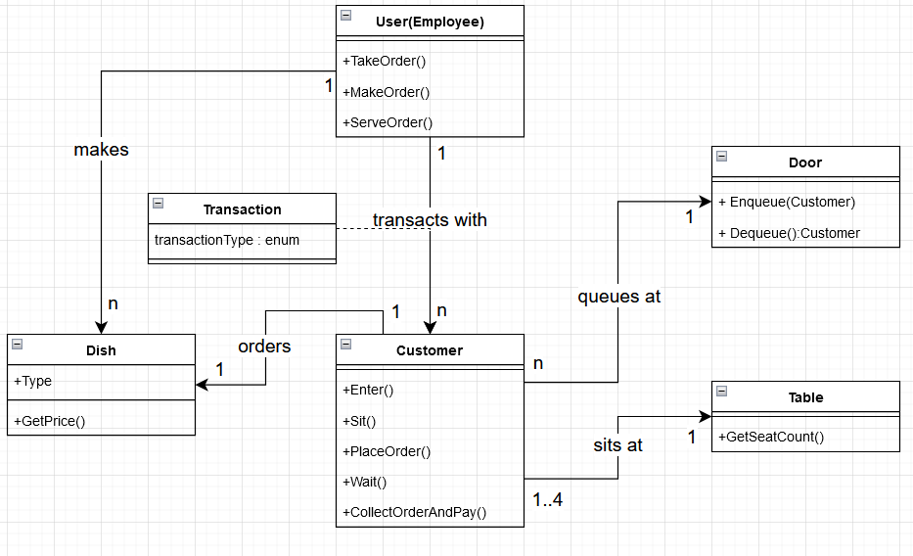
Class Diagram
The customer interacts with all the available objects. Firstly, it waits at the door for an available table. Once there is an available seat, the customer will sit down and begin to order an available dish.
After they have taken the customer’s order, the player will make and deliver the requested dish, the customer will leave after they finish eating.
More than one customer can enter and leave the restaurant at a time as such they will need a table to the corresponding capacity to match.

Slide 4
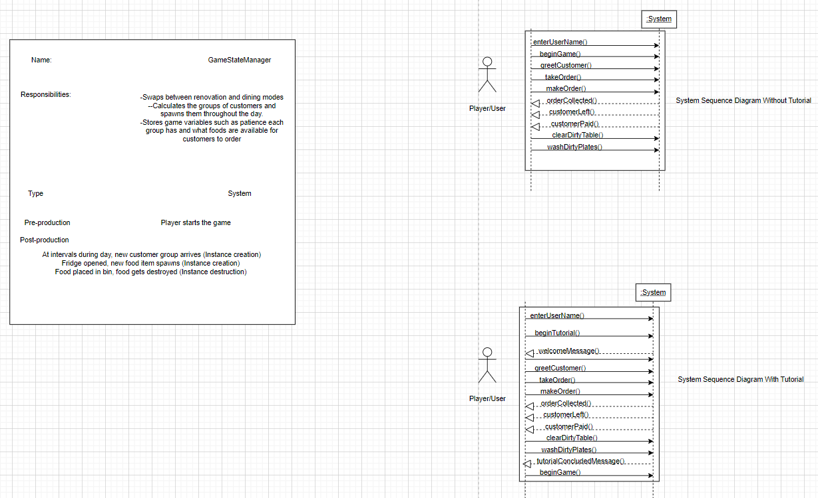
System Sequence Diagram
A sequence diagram describes an interaction by focusing on the sequence of messages exchanged and their corresponding event-occurrences on lifelines.
The sequence diagram highlights the exchange of messages between the player and the GameStateManager in a sequential order.
The diagram states a nice example of how the player should react when a customer enters and once the player acts accordingly the customer will leave.
Notes:
i will now talk about the system sequence diagram as you can probably make out here from the directional arrows
here you are able to see the interaction outlined from beginning to end
as you can see we start the game with the basics entering your username then the next part is what we've based our ssd in which there is the choice to go into tutorial mode or begin gameplay right away without a tutorial
after you trigger the game to begin you appear in the restaurant where the first customer of the day will enter the establishment
the player will then greet them and take their order, make the order, leave it for collection by the customer, which the customer will then eat, leave the restaurant which also simultneously leaves their payment on the table, the player then cleans the dirty table, collects payment and washes the dirty plates
The tutorialised version of this is pretty much the same except the game is guiding you through these steps and telling you what keys to press to achieve these objectives

Slide 5
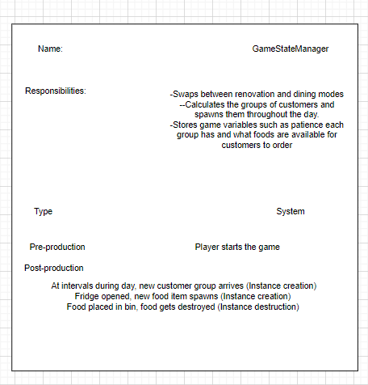
Contracts help define system behaviour
They describe the effects of operations upon the system.
A contract is a document that describes what each system operation commits to achieve.
The GameStateMagager intends to create and destroy instances such as making customers arrive to the restaurant.
Notes:
the contract defining the systems behaviour basically help to put the actions and objectives into computer language
a new customer or new food item spawning would translate into what is essentially "computer speak" for "instance creation"

Slide 6
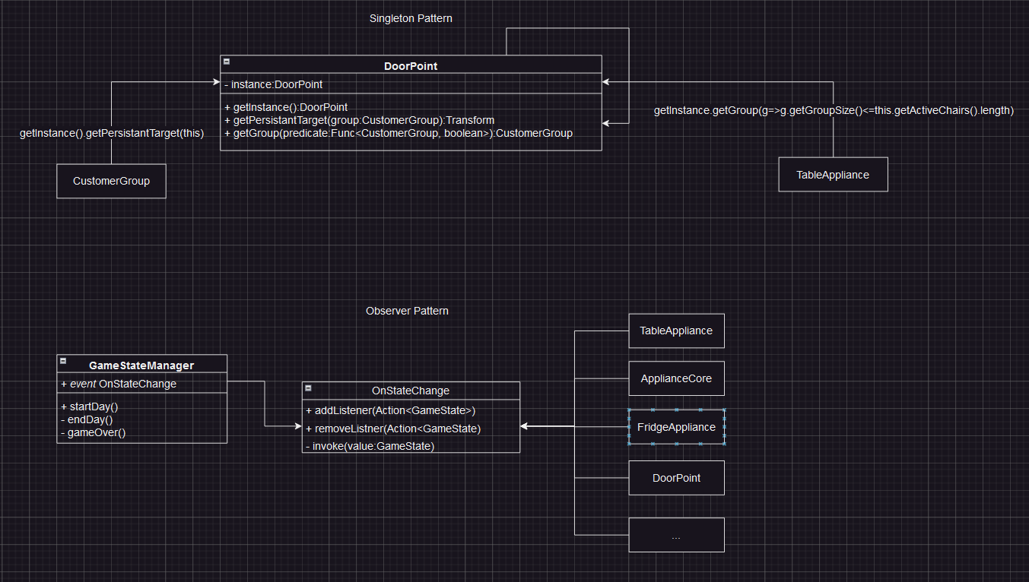
Communication diagram
Communication diagrams are best used for describing communication between objects or patterns commonly executing a system operation
The Singleton pattern is used to allow any class to access the single instance of DoorPoint from any class using the static getInstance method
The Observer pattern describes how the GameStateManager allows any class to listen to the OnStateChange event, and call functions when it occurs
Notes:
Here are two comm diagrams, showing two design patterns
Singleton
DoorPoint is singleton. There will only ever be one doorpoint.
When doorpoint created, doorpoint stores static reference of itself.
Static getter used to allow any class to reference instance
Observer
GameStateManager has event for when it’s state changes
Using the GameStateManager instance, any class can add a listener
Listeners are functios with specific arguments, in this case the new state

Slide 7
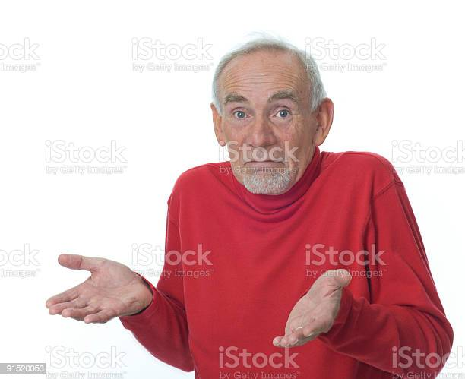


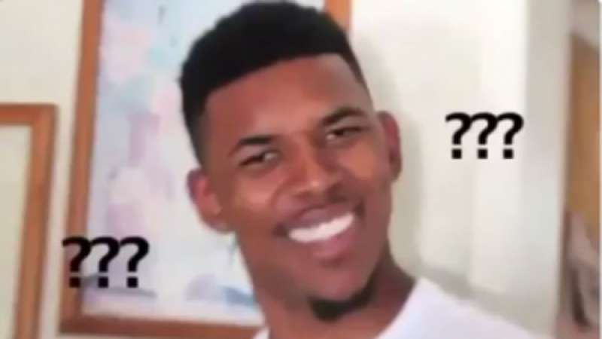
Any Questions

